Slide 1
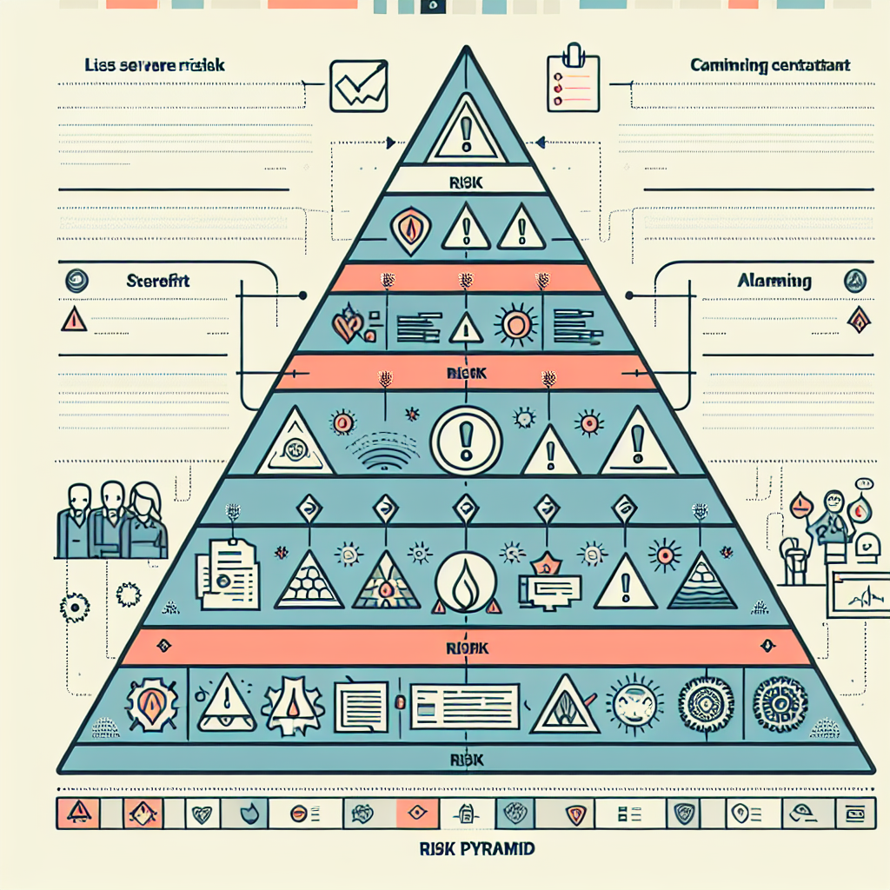
Risk Taxonomy and Examples
Unacceptable — Examples: Manipulative or social‑scoring systems; Real‑time remote biometric ID in public (with narrow exceptions) — Treatment: Prohibited (EU) or highly restricted elsewhere.
High‑Risk — Examples: Employment screening; Creditworthiness; Medical devices; Critical infrastructure — Treatment: QMS, testing, documentation, registration/marking, strong oversight.
Limited‑Risk — Examples: Chatbots requiring disclosure; AI that interacts with the public — Treatment: Transparency obligations; basic controls.
Minimal‑Risk — Examples: Spam filters; AI‑assisted spelling — Treatment: Good‑practice controls; minimal regulation.
EU: Direct mapping to tiers above.
US: Context‑based; align ‘high‑risk’ to safety‑, rights‑, or critical‑function contexts (OMB/NIST).
UK: Principles‑proportionate; treat higher potential harm as ‘high‑risk’.
CN: Risk via security/content impact; uses triggering filing/review treated as high‑risk.

